Slide 1
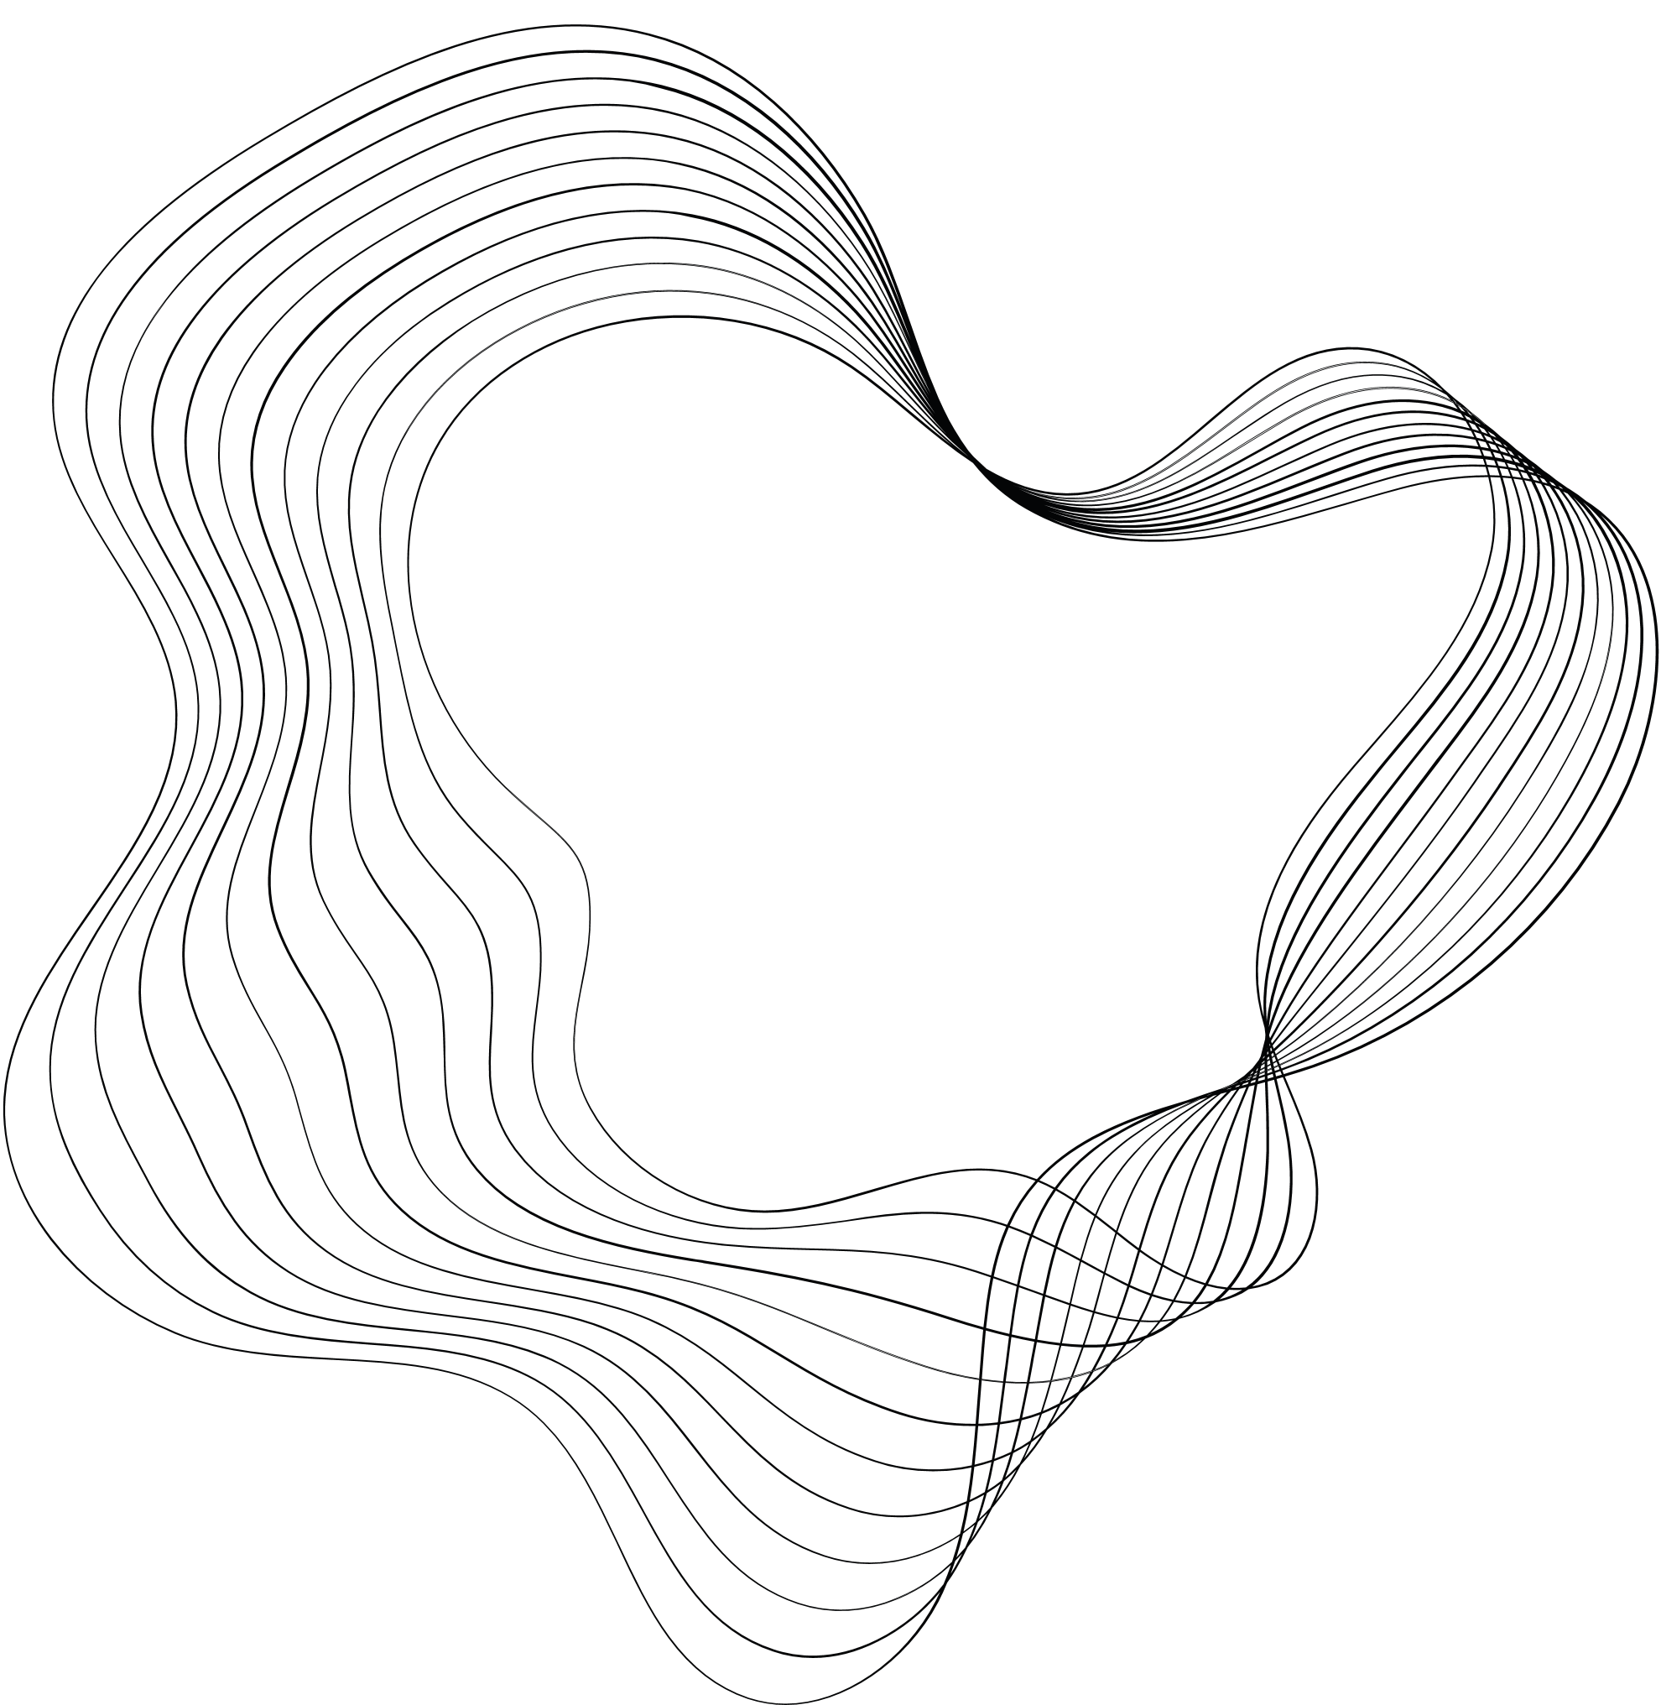

PREDICTIVE AND PREVENTIVE MAINTENANCE SYSTEM
MID DEFENSE PRESENTATION

Slide 2

OUR TEAM
Muhammad
Nauman
M. Junaid Maqsood
M. Hassan Khan
M. Zain-ul-Abeedin
Supervisor
01-132202-015
01-132202-022
01-132202-035

Slide 3
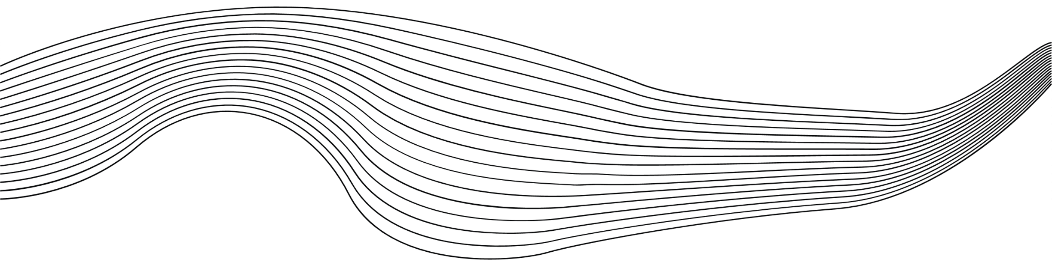
CONTENT
01
BACKGROUND
08
SCOPE
02
PROBLEM STATEMENT
09
TIMELINE
03
LITERATURE REVIEW
10
FRONT END
04
OBJECTIVES
11
QUESTIONS
05
DATASET
12
REFERENCES
06
DATA PRE-PROCESSING
07
METHODOLOGY

Slide 4

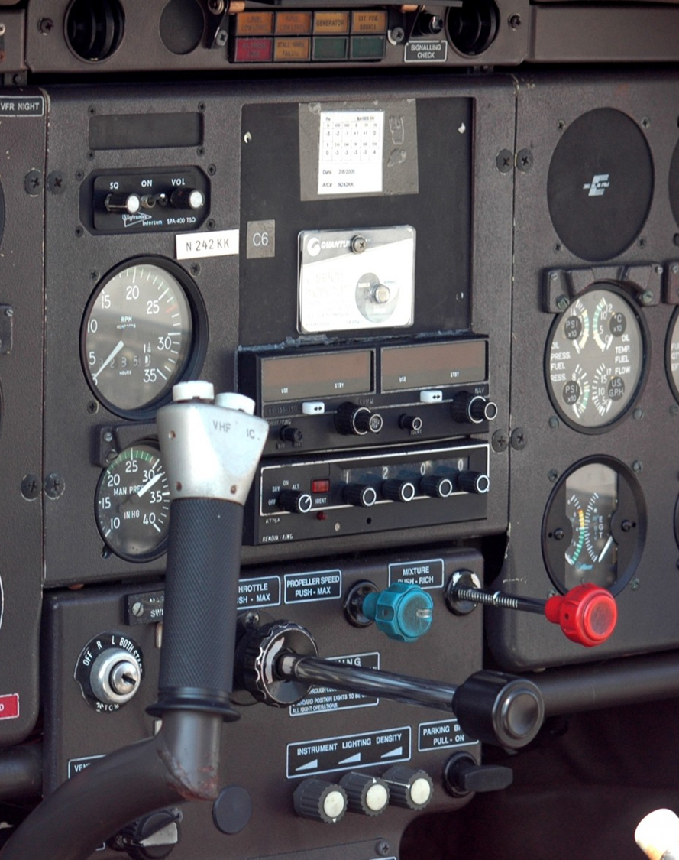
BACKGROUND
The turbofan jet engines are an important part of aircrafts, and their reliable performance is crucial for air travel.
However, there can be unexpected failures or malfunctions in engines which can cause many problems such as
Increased maintenance costs.
Compromised passenger safety.
Flight cancellations.
Substantial financial losses for airlines.

Slide 5
BACKGROUND
The Airline Maintenance Cost Executive Commentary Edition 2019 reported the annual maintenance, repair, and overhaul cost was 9% ($69 billion) of the total operational cost.
Traditional maintenance approaches, such as scheduled or reactive maintenance, often result in suboptimal resource allocation, increased downtime, and higher maintenance costs.
Pros
Simple
Familiarity
Cons
Reactive
Increased Risk
Inefficient
Lack of visibility

Slide 6

PROBLEM STATEMENT
To automate a system that calculates the remaining useful life of turbofan jet engines and alert the maintenance officers to provide maintenance to required aircraft before any failure or malfunctions occur.

Slide 7

LITERATURE REVIEW
YEAR | AUTHORS | WORK DONE | RESULTS | REMARKS
2023 | Koosha Sharifani, Mahyar Amini | REVIEW OF METHODS & APPLICATIONS OF ML & DL | - | A commendable and well-organized exploration of machine learning and deep learning, addressing their distinctions, applications, and industry impacts.
2021 | Kwok Tai Chui , Brij B. Gupta , and Pandian Vasant | Optimized RNN-LSTM Model | Improved RMSE by 12.95% to 39.32%. | This paper provides a well-structured and insightful exploration of remaining useful life (RUL) prediction for turbofan engines.
2019 | Xiang Li, Qian Ding, Jian-Qiao Sun | Deep Learning Algorithm. | RMSE Support vector machine 29.82 Random forest 17.91 First attempt of deep CNN 18:45 LSTM 12:81 | Research on machine learning algorithms as well as deep learning method based on convolution neural networks and drop out techniques is employed to relieve overfitting problem.

Slide 8
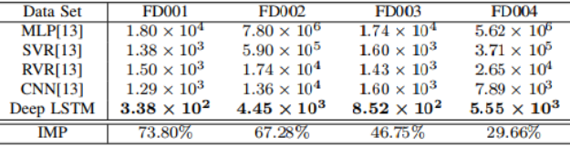
LITERATURE REVIEW
YEAR | AUTHORS | WORK DONE | RESULTS | REMARKS
2019 | André Listou Ellefsen Emil Bjørlykhaug Sergey Ushakov | Deep learning (DL) techniques like CNN and LSTM | Better RUL prediction accuracy compared to purely supervised learning. | Overall, the research suggests that semi-supervised learning is a promising technique for RUL prediction in turbofan engines when labeled data is scarce.
2017 | Shuai Zheng | Comparison of LSTM with other algorithm |  | The paper introduces an LSTM network for Remaining Useful Life (RUL) estimation, effectively leveraging sensor sequence information to reveal hidden patterns in diverse operating conditions, fault scenarios, and degradation models.

Slide 9





OBJECTIVES
Objective n° 1
Objective n° 2
Objective n° 3
Predict the Remaining useful life of turbofan engines
Predict when an aircraft needs maintenance.
To achieve high accuracy.
Objective n° 4
Objective n° 5
Reduce maintenance costs.
Improve passenger safety.

Slide 10
DATASET
Data sets consists of multiple multivariate time series.
Each engine starts with different degrees of initial wear and manufacturing variation which is unknown to the user.
The engine is operating normally at the start of each time series, and develops a fault at some point during the series.

Slide 11



DATA PRE-PROCESSING
Irrelevant columns are dropped from the ‘jet_data’ Data Frame using the drop method.
The RUL column is added to the data using the ‘RUL_calculator’ function, which calculates the remaining useful life based on the maximum cycle for each engine.
Irrelevant sensor columns are dropped to create a new DataFrame (jet_relevant_data) with relevant parameters
DROPPING IRRELEVANT COLUMNS
CREATING A NEW DATA FRAME WITH RELEVANT PARAMETERS
ADDING RUL COLUMN

Slide 12
DATA PRE-PROCESSING
•Sensor 9 is dropped based on data variation.
Features are scaled using the Min Max Scaler from scikit-learn.
The target variable (label) is created based on a threshold (cycle) for remaining useful life
REMOVING SENSOR 9 BASED ON DATA VARIATION
SCALING FEATURES
CREATING TARGET VARIABLE AND FEATURE MATRIX

Slide 13
MODEL USED
Random Forest Classifier
Machine Learning
Used for Time-Multivariate

Slide 14

METHODOLOGY
Input test data
Import data using pandas library
Remaining useful life estimation
Create function to calculate the remaining useful life
Result evaluation
Accuracy for classifiers
RMSE for regressors
Handling categorical data
Label Encoding
On-hot encoding
Feature scaling
Min-max scaling
Robust scaling
Feature extraction
Auto-encoders
Using the built-in version of pandas library in python
ESTIMATING RUL
FEATURE EXTRACTION
ACQUIRING DATASET
DATA PRE-PROCESSING
MODEL TRAINING
DASHBOARD
Dealing with outliers
If any replacing with mean, median will help
Applying logarithm or square root to reduce the impact of values
Model selection
Import models from model_selection
RFC
Splitting data
Splitting data in training and test sets using train_test_split
Create a dashboard
Using web app or website for dashboard
Sign in for staff and authorized personnel
Easy to monitor condition of Machines
Using statistical or graphical visualization of data

Slide 15

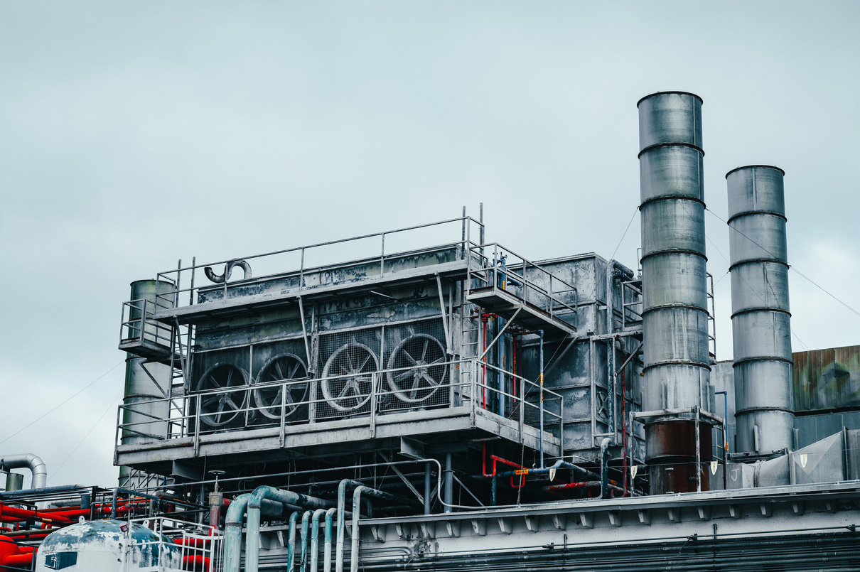
SCOPE
Aviation
Complex machines
Neglecting maintenance can lead to:
Mechanical failures
Risk of accidents
Compromise passenger safety
Decreased output quality
Industrial
Extensively used in industries:
Optimize production processes
Maintain efficiency
Neglecting maintenance can lead to:
Decreased efficiency
Machine may experience breakdown
Decreased output quality

Slide 16
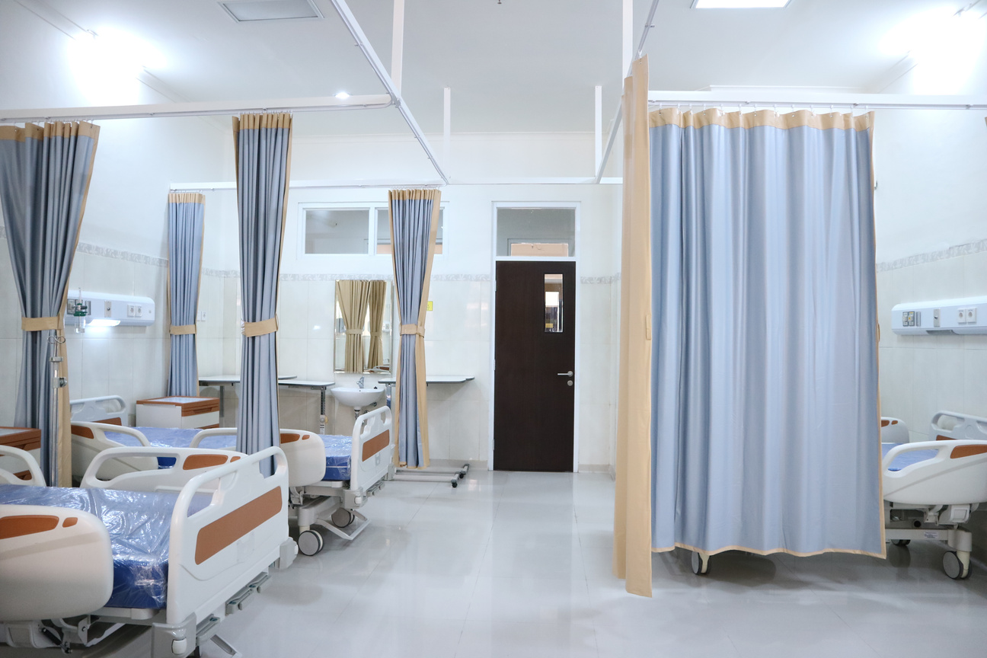

SCOPE
Hospital:
Hospital equipment is critical for:
Patient care
Diagnostics
Treatment.
Neglecting maintenance can lead to:
Calibration errors.
Malfunction.
Inaccurate readings.
Networking fields for maintaining servers in warehouses:
Backbone of IT infrastructure supporting:
Data storage.
Processing.
Network operation.
Neglecting maintenance can lead to:
Decreased performance.
System crashes.
Potential security breaches.

Slide 17


TIMELINE
01
02
03
04
05
06
JUN – JUL 2023
AUG - SEP 2023
OCT - NOV 2023
DEC - JAN 2024
FEB – MAR 2024
APR - MAY 2024
Project problem view, proposal preparation and defense.
Literature Review, learning required concepts and installation of required tools.
Performing pre-processing, feature engineering etc. on the dataset.
Implementation and training of Machine / Deep Learning model used to predict remaining useful life and maintenance time.
Create front end for operator to check the statistics and when the maintenance is required
Final Research Document, Submission of Project, and Final Defense

Slide 18
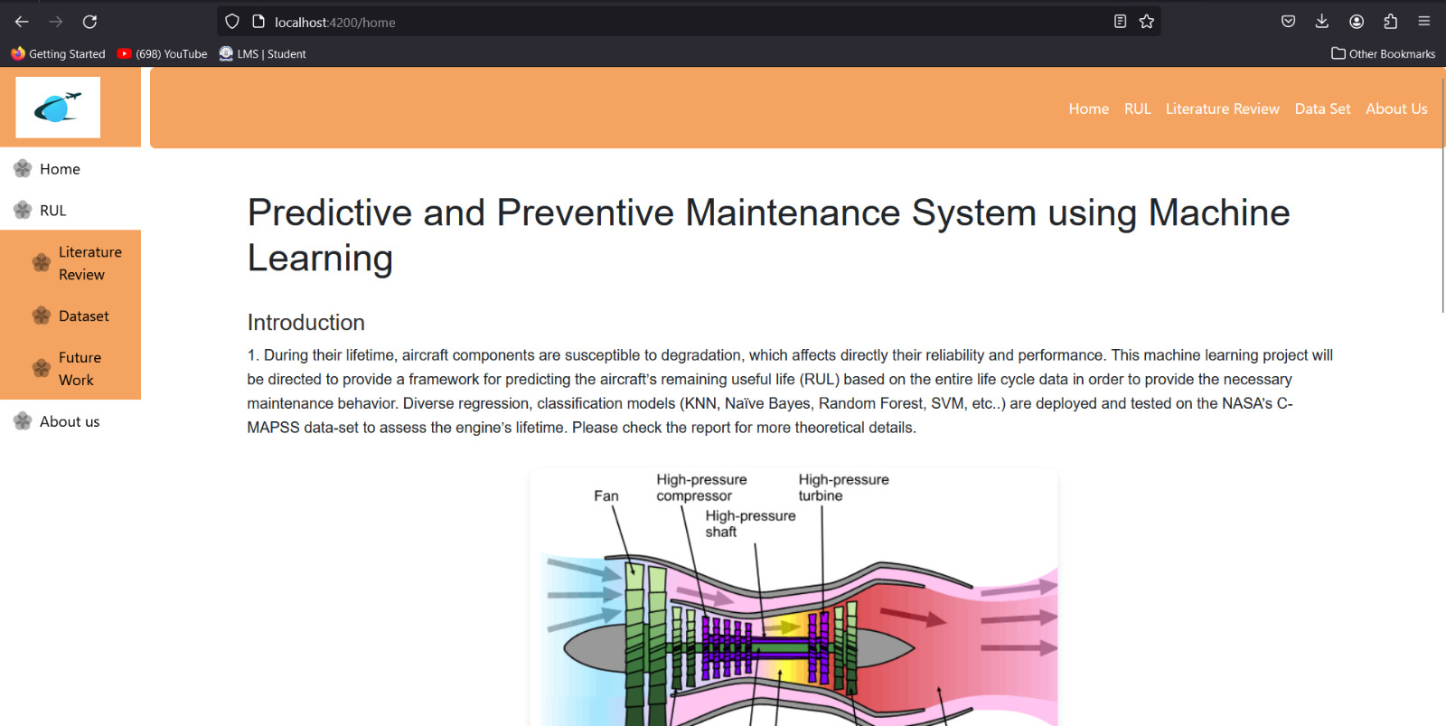
FRONT END
Web Application
Home page
Front end for Our final year project is built using Angular, offering a modern and responsive user interface. Leveraging Angular's robust features, our website provides seamless navigation, dynamic content delivery, and interactive user experiences, making it a valuable addition to the digital landscape.

Slide 19
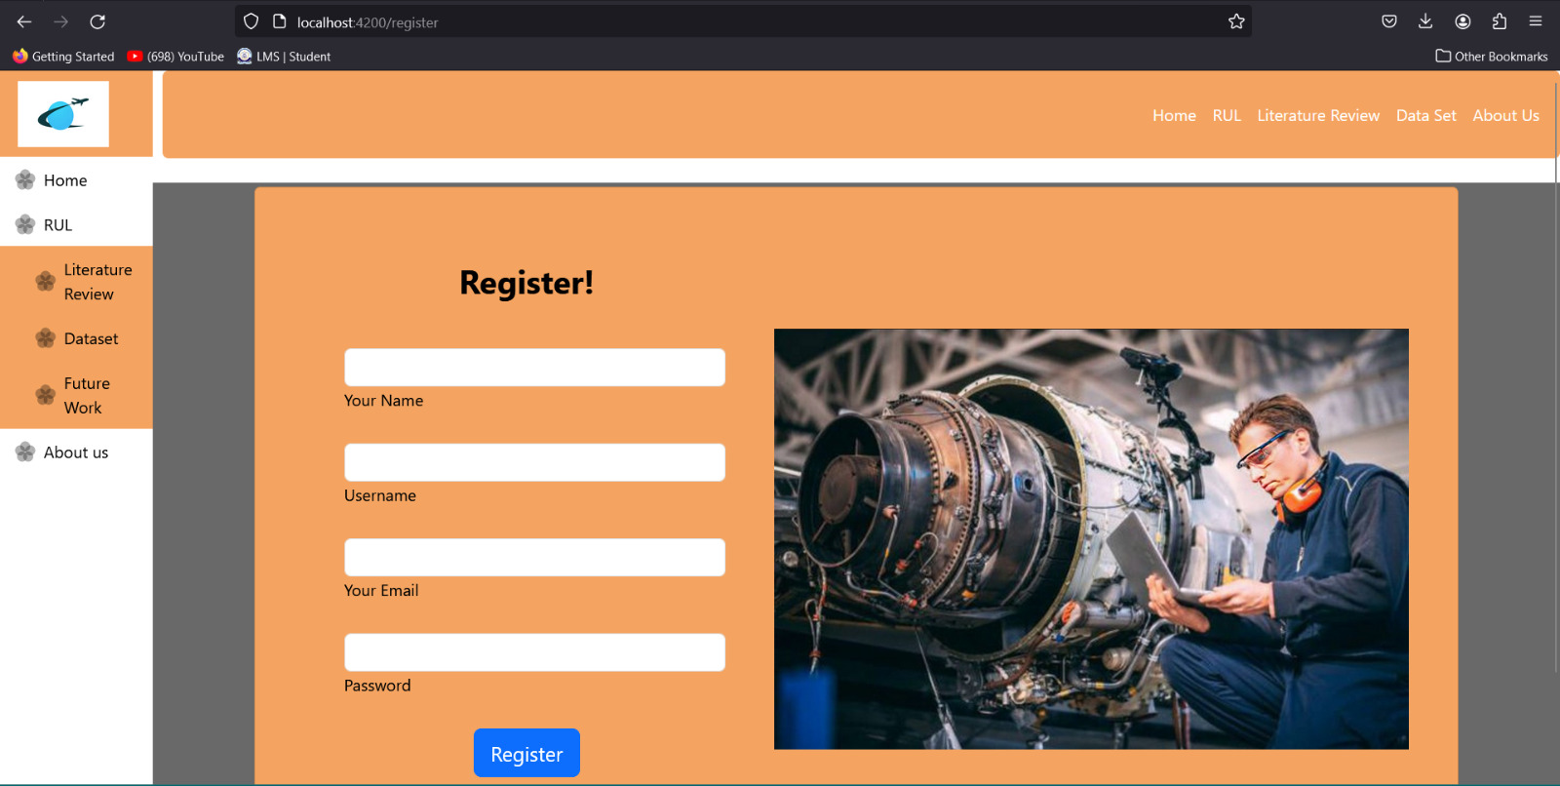
FRONT END
We Application
Registration page

Slide 20
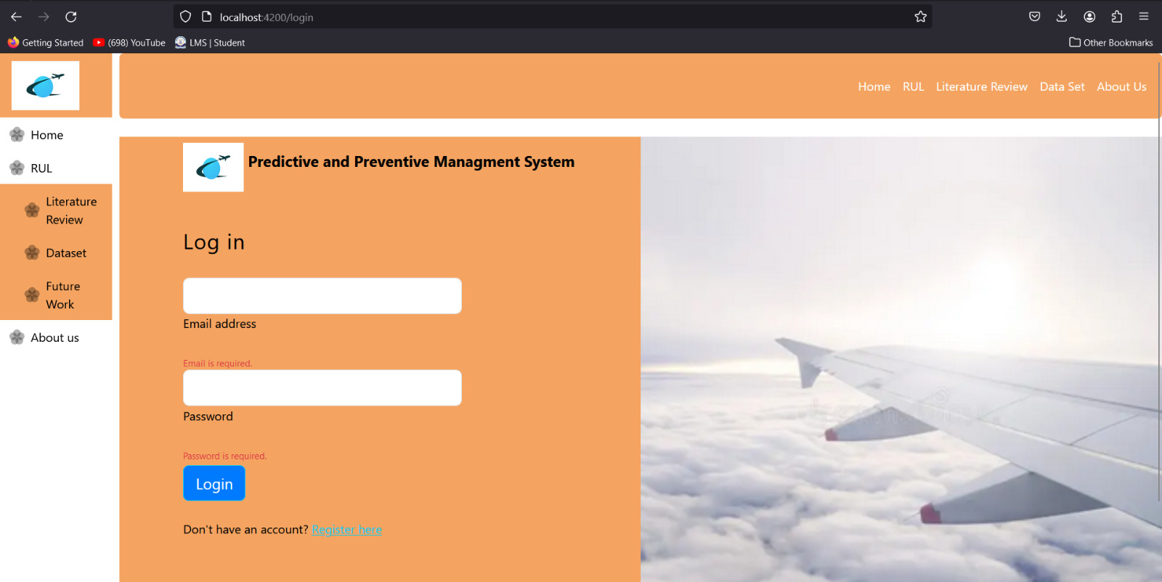
FRONT END
We Application
Login page
.

Slide 21
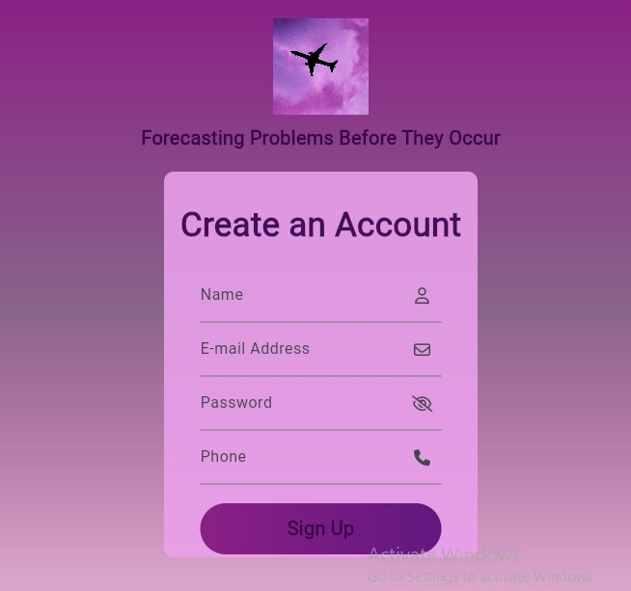
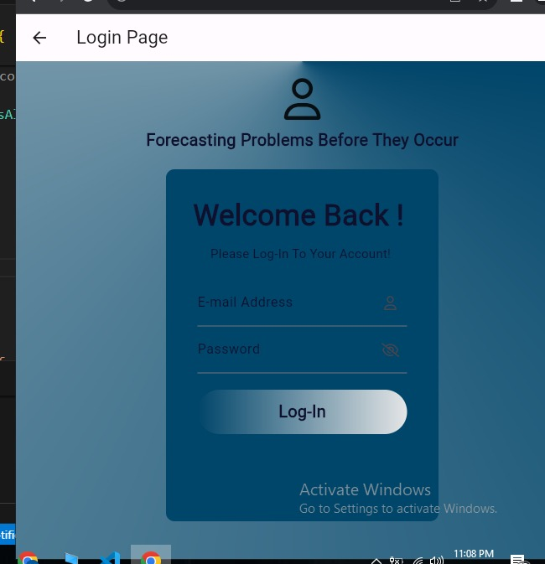
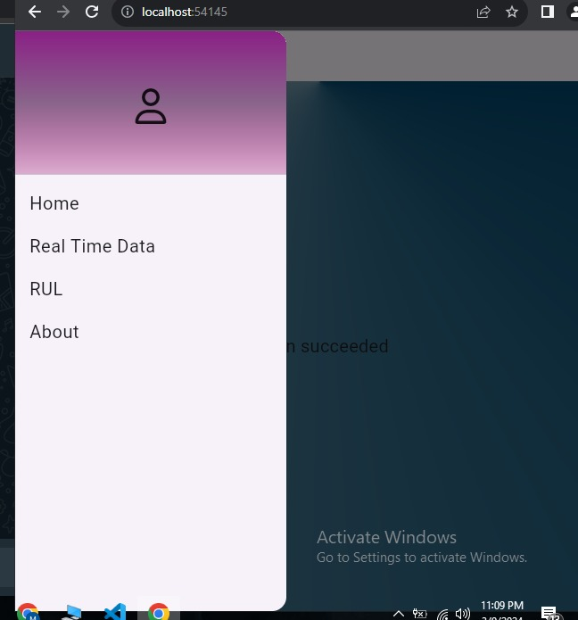
FRONT END
Mobile Application
Mobile App developed using Flutter and Dart Language. App based on multiple pages with Registration ,login and etc. pages. A side bar with multiple options and features for the real time updates.
====Registration Page----------
----------Login Page-==---

Slide 22

THANK YOU!
Any Questions?

Slide 23

REFERERENCS
Koosha Sharifani, Mahyar Amini. Machine Learning and Deep Learning: A Review of Methods and Applications.
Kwok Tai Chui , Brij B. Gupta , and Pandian Vasant. A Genetic Algorithm Optimized RNN-LSTM Model for Remaining Useful Life Prediction of Turbofan Engine.
Xiang Li, Qian Ding, Jian-Qiao Sun. Remaining Useful Life Estimation in Prognostics using Deep Convolution Neural Networks.
André Listou Ellefsen, Emil Bjørlykhaug, Sergey Ushakov. Remaining useful life predictions for turbofan engine degradation using semi-supervised deep architecture.
Shuai Zheng. Long Short-Term Memory Network for Remaining Useful Life Estimation.
https://www.mathworks.com/videos/series/predictive-maintenance-tech-talk-series.html

